Slide 1
Basic Verilog RTL

Slide 2
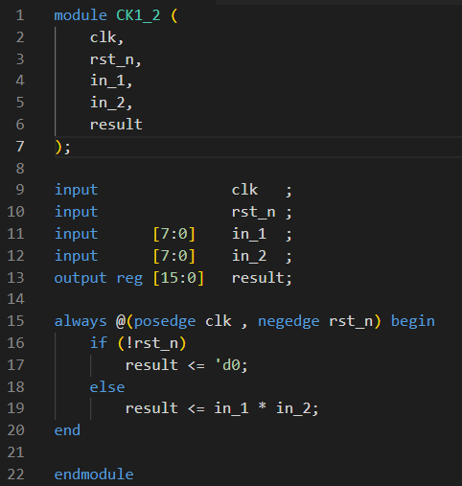
Module
Module frame
Variable declare
Module body

Slide 3
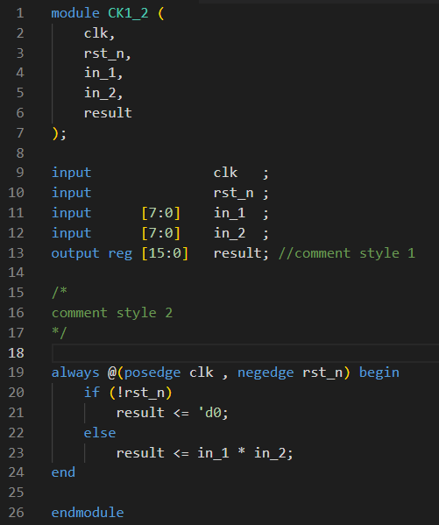
Basic Syntax
End statements with ;

Slide 4
Basic Syntax
Two style of comments
Single line comment after “//”.
Block comment from “/*” to “*/”.

Slide 5
Basic Syntax
Use begin … end to compound statements.
{} is used to combine signals in verilog.

Slide 6
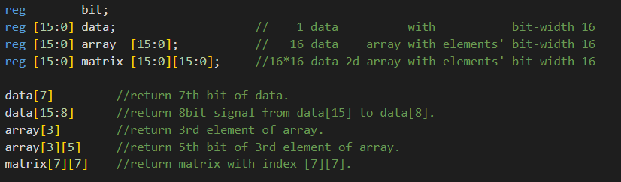
Declare variable
<type> [MSB:LSB] <variable>
Type : reg or wire for RTL.
[MSB:LSB]: determine bit width.

Slide 7
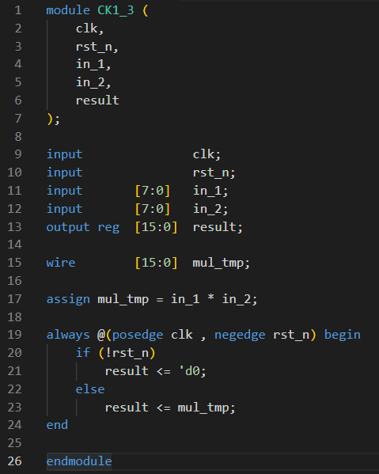
Data type
wire
Continuously driven signal.
Use “assign” to assign a value or operations.
Only for combinational signals.
assign only be used outside always blocks.
Default type of output ports is wire.

Slide 8
Data type
reg
Default is X (unknown).
Assigned in always block.
For combinational or sequential signals.
Can not be assigned by 2 or more always blocks for RTL design.
Data type | wire | reg
assignment | assign | Always block
Combinational | O | O
Sequential | X | O

Slide 9
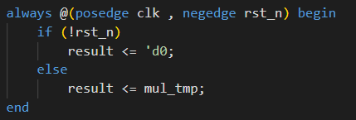
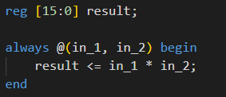
Always Block
Event driven block.
Start procedure if event triggered.
Can be used for combinational or sequential blocks.

Slide 10
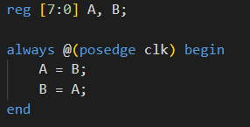
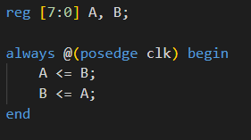
Blocking and non-blocking assignment
Blocking assignment (=)
Non-blocking assignment (<=)
Execute statements line by line.
As B = A = B, A and B will stuck at same value.
Execute statements at same time.
Swap A and B every cycle.
Highly recommended for sequential circuits.

Slide 11
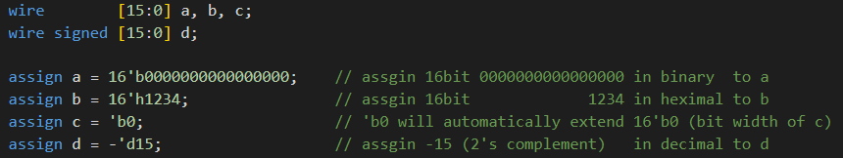
Value Representation
Value format:
Constant: <size>’<base><value>
<size> : bit width.
<base> : b, o, d, h.
<value> : value in <base> representation

Slide 12
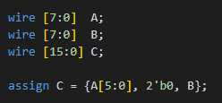
Bus Concatenation

Slide 13
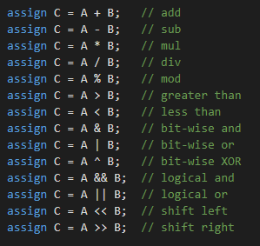
Operations

Slide 14
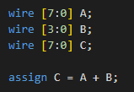
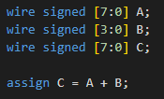
Signed Issue
B will be zero extended to 8 bits.
B will be sign extended to 8 bits.
Both operands must be signed.

Slide 15
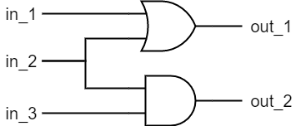
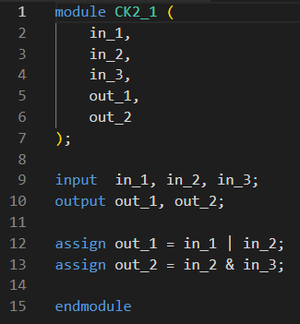
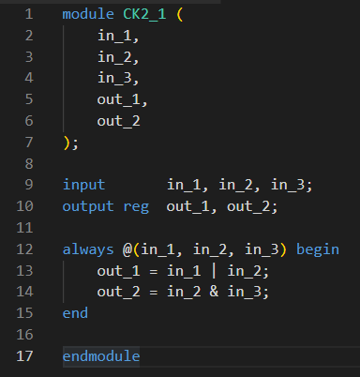
Combinational Circuit

Slide 16
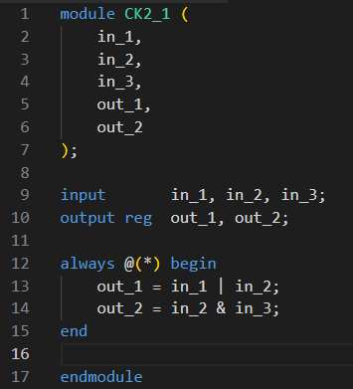
Combinational Circuit
recommended

Slide 17
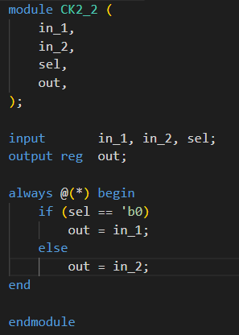
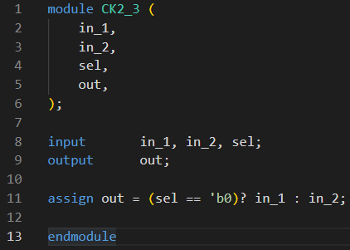
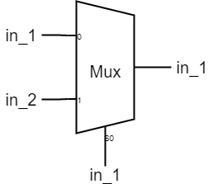
If-else
in-line style

Slide 18
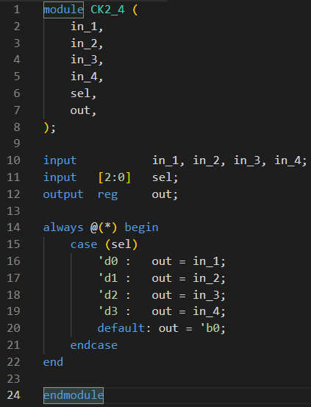
Case

Slide 19
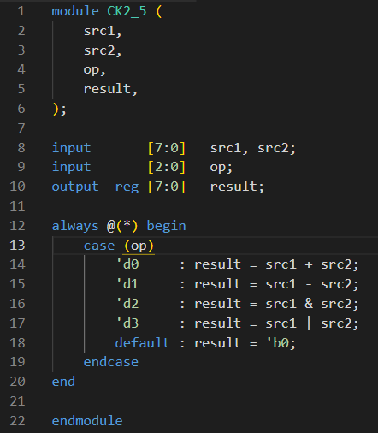
ALU with Case

Slide 20
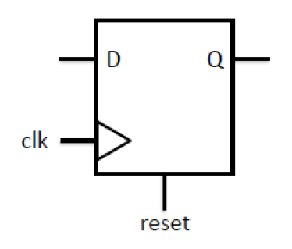
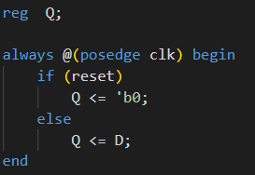
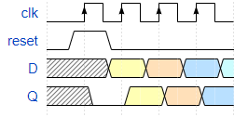
Sequential circuit
Active high and Synchronous reset

Slide 21
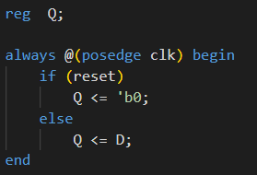
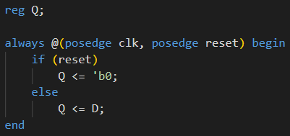
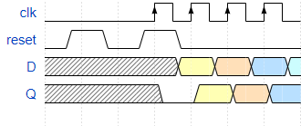
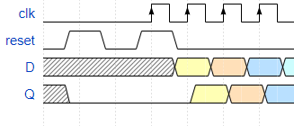
Synchronous and Asynchronous Reset
Synchronous & active high
Asynchronous & active high

Slide 22
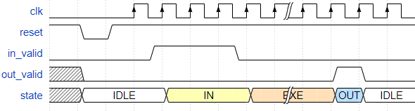
Finite State Machine (FSM)
S_IDLE
S_OUT
Next state
generator
S_IN
S_EXE
Current state
Next state
Current state
register

Slide 23
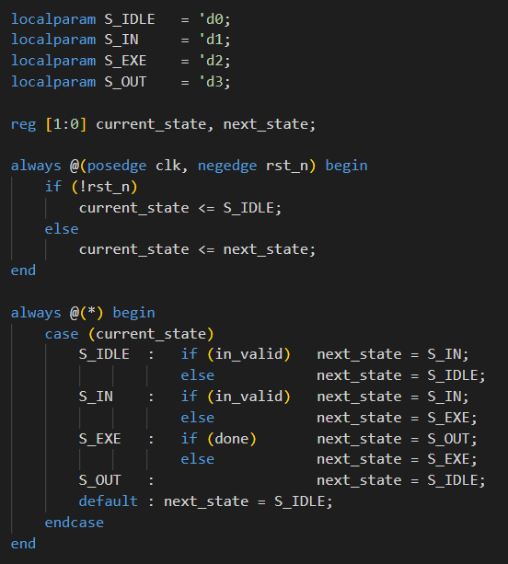
Finite State Machine (FSM)
Next state
generator
Current state
Next state
sequential
Current state
register
combinational

Slide 24
Finite State Machine (FSM)
S_IDLE
S_OUT
S_IN
S_EXE
combinational

Slide 25
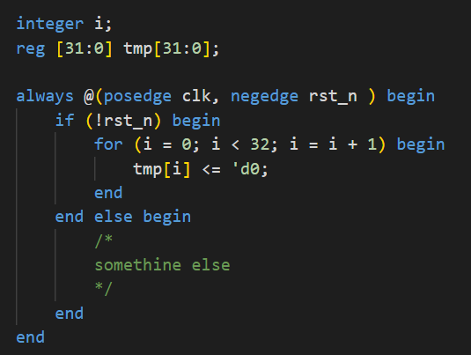
for loop example

Slide 26
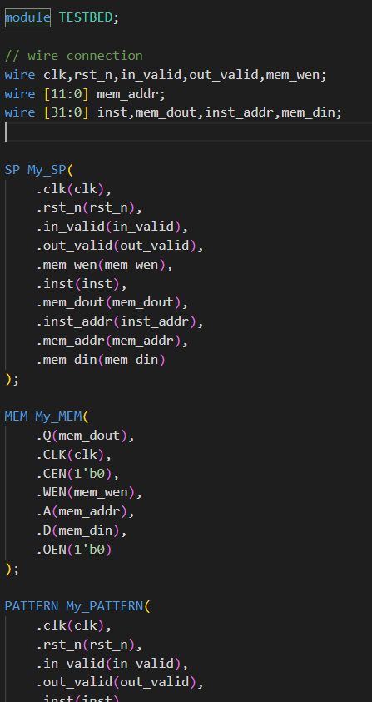
Testbed

Slide 27
Testbed

Slide 28
Testbed

Slide 29
Recommended Text Editor
VS code with Verilog extension
Notepad++
Sublime

